Slide 1
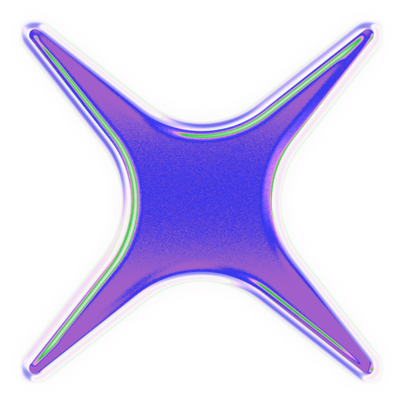

NLP 2026
SYMPHONY OF WORDS:
POETRY GENERATION WITH
MARKOV CHAINS AND CRPO
İlayda Tiryaki
Maria-Daria Tompea

Slide 2
AGENDA
Problem Statement
Proposed Solutions
Markov Chains
Crpo
Dataset
Application
Implementation
Results

Slide 3
Problem Statement
The Core Task: Computational synthesis of poetry under formal and stylistic constraints.
Key NLP Challenges:
Structural Integrity: Maintaining rhyme schemes and rhythmic patterns (meter).
Semantic Coherence: Ensuring the generated text conveys a unified meaning rather than random words.
The Goal: To evaluate and implement two distinct approaches: Stochastic (Markov) and Neural (CRPO) to bridge the gap between creative freedom and algorithmic control.

Slide 4
Maria-Daria Tompea
Markov Chains
1
Model Architecture:
Implementation of a 2nd-Order Markov Chain.
State space defined by word pairs (Word-1, Word-2) to maintain local syntax.
Training & Probability:
Corpus: Trained on poetic datasets (e.g., Dylan corpus).
Method: N-gram Relative Frequency for transition estimation.
2
Algorithmic Constraints:
Rhyme Constraint: Unary constraint filtering via manual rhyme checking.
Semantic Injection: Forced 'Seed Word' integration to guide thematic output.
Poetic Structure:
Automated AABA and AABB rhyme scheme generation.
Dynamic line count control (Couplets vs. Quatrains).
3
4

Slide 5
İlayda Tiryaki
Neural Language Modeling (CRPO)
1
Deep Learning Architecture:
Hybrid Neural Network
Layer Composition
Attention Mechanism
Interactive Control:
Semantic Steering
2
Generation Strategy:
Sampling with Temperature
Context Window
Neural-Rule Integration:
Phonetic Injection
Heuristic Cleaning
4
3

Slide 6
İlayda Tiryaki
Data Set: Gutenberg Poetry Corpus
Scale: ~3,000,000 lines of poetic text.
Scope: Large-scale collection of public domain English poetry.
Data Diversity: Includes various historical periods, styles, and authors.
Processing Pipeline:
Selection: 20,000 high-quality lines for optimized training.
Refinement: Removal of metadata, headers, and archaic symbols.
Tokenization: Character-level mapping for Bi-LSTM and word-level for Markov.
Linguistic Features: High lexical richness and diverse rhythmic patterns.

Slide 7
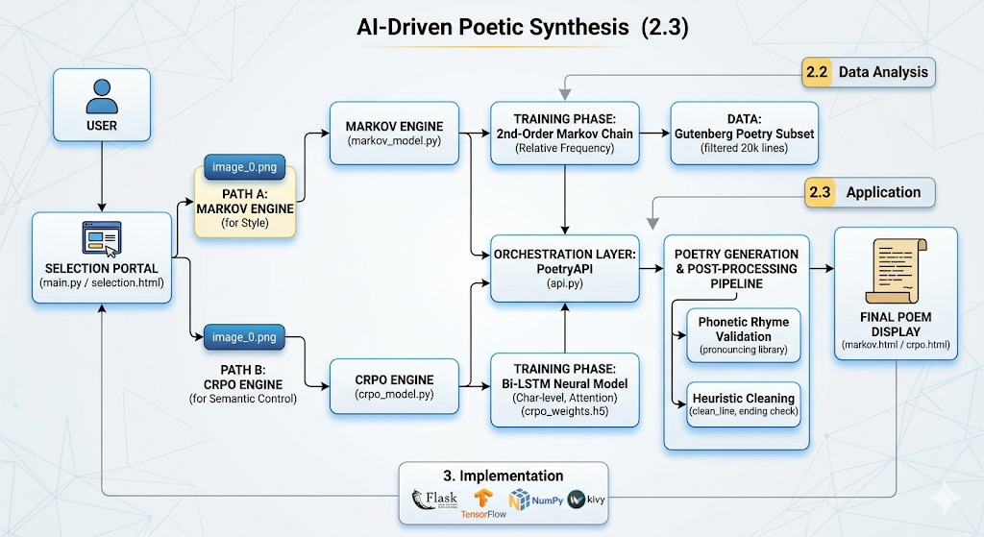
Application

Slide 8
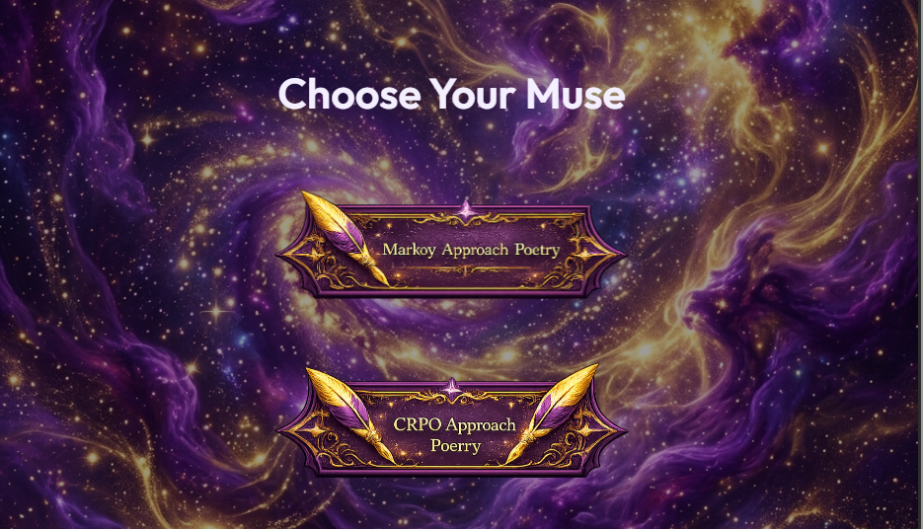
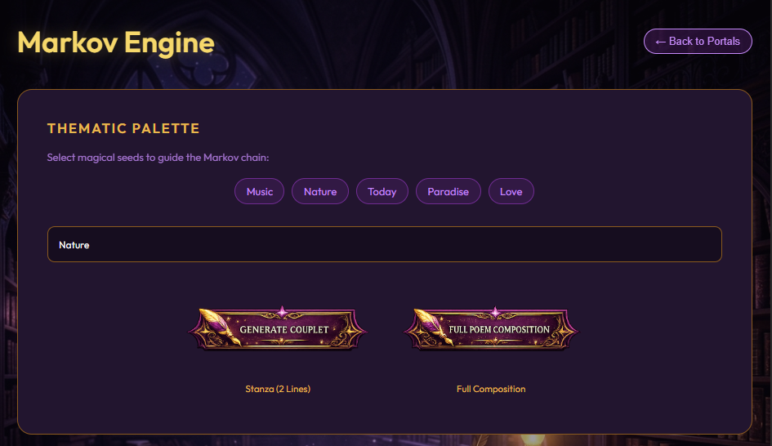
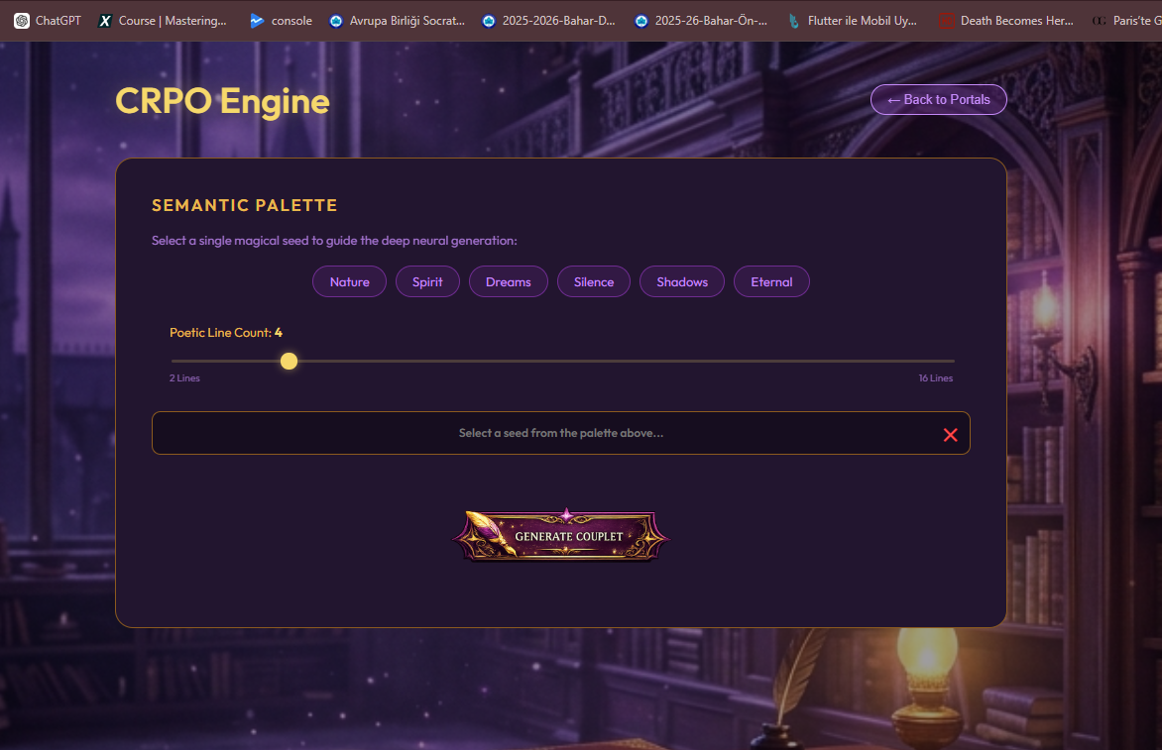
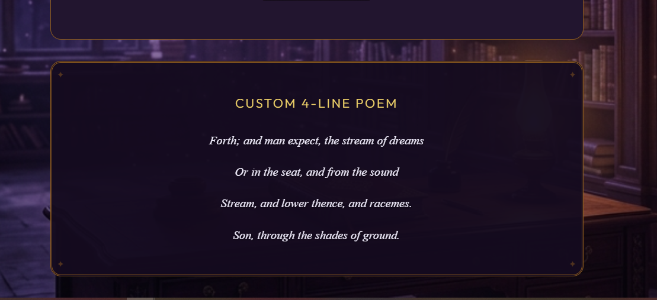
1
2
3
4

Slide 9
Implementation
Neural Synthesis (_predict): Character-level Bi-LSTM inference.
Creative Control (temperature): Balancing randomness vs. coherence.
Hybrid Injection (_generate_line): 70% Neural + 30% Phonetic Rhyming.
Stylistic Modeling (train): 2nd-order Markov relative frequency.
Automated Editor (_clean_line): Heuristic syntactic refinement.
Language: Python 3.x
Backend: Flask Web Framework
Neural Engine: TensorFlow / Keras
(Math & Sampling: NumPy
Phonetics: 'Pronouncing' Library
(Text Cleaning: Regex (Re)

Slide 10
Experiments & Results
Comparative Performance:
Markov Model: Highest scores in Stylistic Mimicry (capturing the specific vocabulary and tone of the corpus).
CRPO Model: Superior Semantic Flexibility; effectively guided by seed words through Bi-LSTM attention.
Key Metrics:
Rhyme Accuracy: ~90% success rate achieved via Phonetic Injection (Hybrid approach).
Efficiency: Average poem generation time < 2.5 seconds.
Syntactic Fluency: Heuristic cleaning reduced "broken line endings" by 85%.
User Interaction Success:
Successful integration of Stochastic control (Temperature) allowed for diverse output variations without retraining.
AABA/AABB schemes were consistently maintained across multiple test runs.

Slide 11
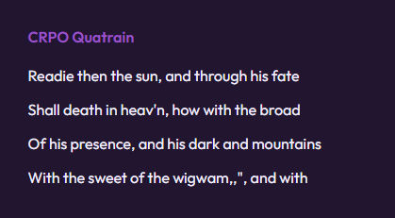
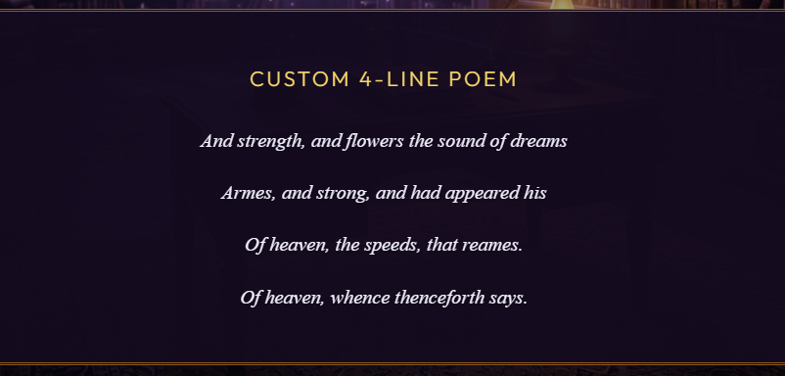
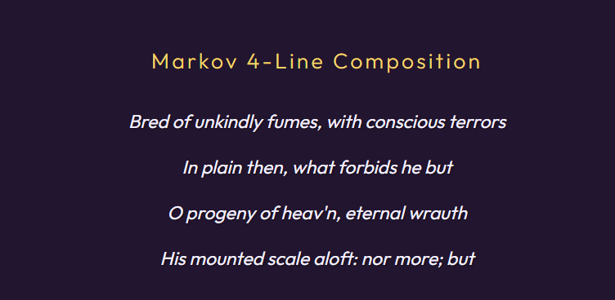
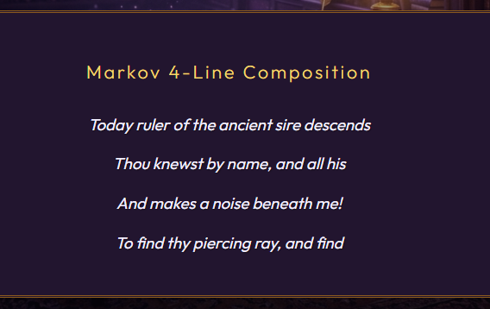
Before filtering
After filtering

Slide 12

Thank You

